Slide 1
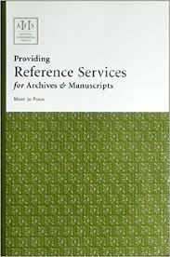
CHAPTER 4 Management of Archive Materials
REFERENCE SERVICES

Slide 2
REFERENCE SERVICES
An archival institution, whether public or private, must plan and maintain appropriate reference services for all users.
These archives are used for research or reference by a wide variety of users, from government officials to academic readers to members of the general public.
Archival institutions must provide good reference services in order to ensure all users can access archival materials.

Slide 3
References services connected with the:
reference / search department
managing the reference area
registration of users / researchers
ordering and producing archive
Consulting archival documents by the creating agencies
Producing archives for the transferring agency
Returning archival materials
Providing a reference library in the archival institution

Slide 4
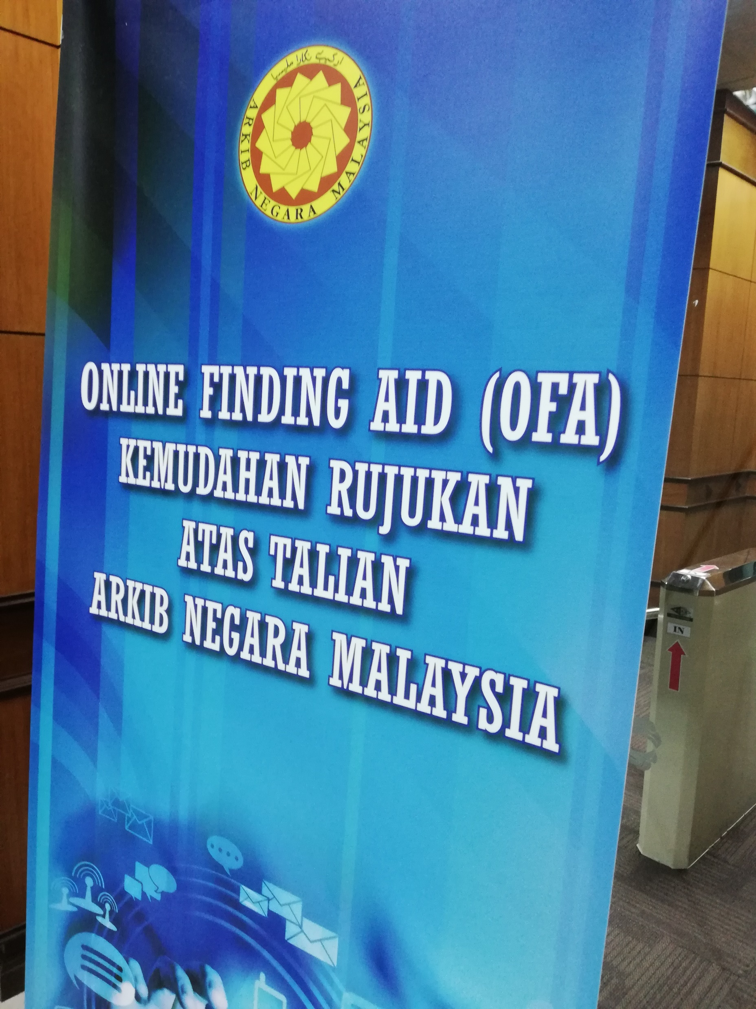
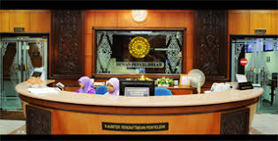
1. REFERENCE / SEARCH DEPARTMENT
The reference or search department is the contact point for members of the public and agency officials who wish to find out about the holdings of the institution.
Researchers may contact the institution by correspondence, by telephone or in person.

Slide 5
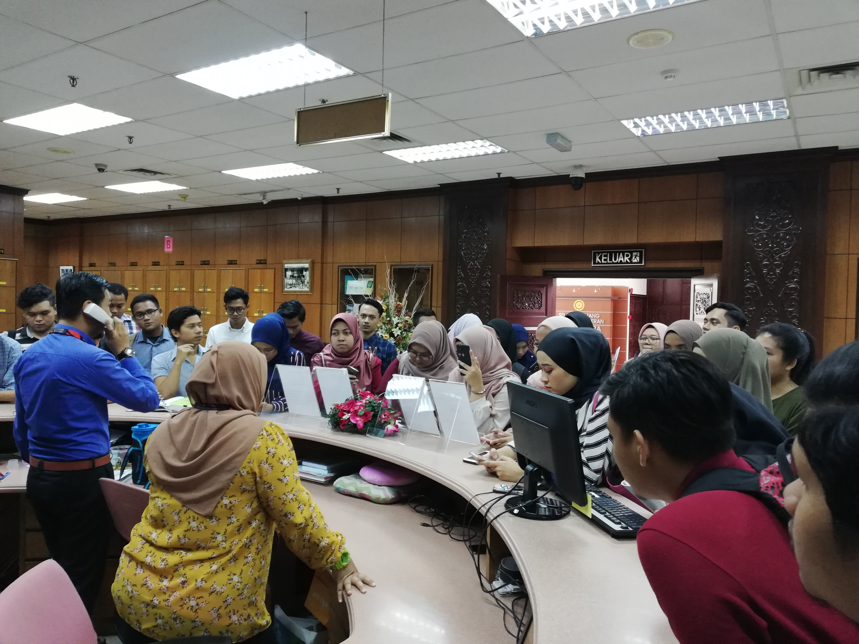
2. MANAGING THE REFERENCE AREA
The reference area, often called the search room, is a controlled sector within the institution in which users can consult archival materials in an atmosphere conducive to study
When researchers arrive at the archival institution, there should be clear signs directing them to the search room.
Directions not only put them at their ease but also help prevent their straying into restricted, ‘staff only’ areas.

Slide 6
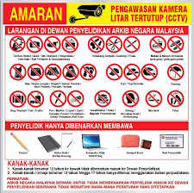
The conduct of everyone in the search room must be controlled by a set of rules based upon current legislation or policies.
To protect the records, all users must abide by clearand documented reference rules.

Slide 7
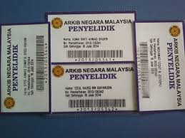
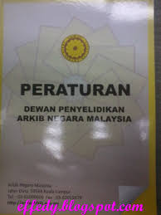
3. Registration of Users / Researchers
Users/researchers must register themselves before can be allowed to enter Reference Room / Search Room.
Professional archival practice worldwide is that all users should identify themselves when they attend at the search room and that a permanent record should be kept of all users and of the materials consulted.

Slide 8
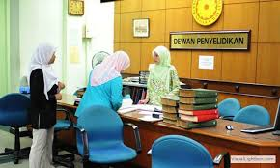
4. ORDERING AND PRODUCING ARCHIVE
Any archival materials that have been requested by and issued to researchers must be tracked properly.
A tracking procedure always makes it possible to protect archives when they are out of storage.

Slide 9
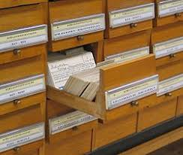
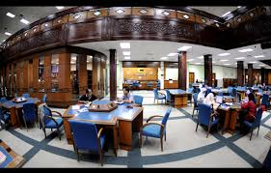
Users / researchers must have ready access to the finding aids (guides, group-level descriptions, item lists and Indexes).
When readers have identified the materials they want to see, they should make out a production form then hand it to a search room staff.
It is wise to limit the number of items produced for a researcher at any one time.

Slide 10
No item can be produced unless a production form has been completed and handed to the reference staff.
This rule applies to all archival documents, no matter whether the production form has been completed by a member of the archives staff, a government official or a member of the public.
No documents should be made available to anyone who does not have a valid registration as a users.

Slide 11
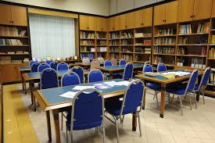
5. Consulting Archival Documents by the Creating Agencies
As an alternative to sending a member of staff to consult documents in the search room, records and archives legislation should provide for archival materials to be requisitioned for use by the agency that created or transferred them to the archival institution.
Occasionally archives may also be requested by other agencies within the government or organization.
There should be a provision in the institution’s regulations of the institution to allow ministers or senior officials to requisition items.

Slide 12
6. Producing Archives for the Transferring Agency
Archival items sent to creating or transferring agencies for use must be treated with the same care as if they were being consulted in the search room.
To protect against the removal of documents from a file, or any change in the order of documents within a file, a statement of original order form may be inserted inside loaned items.

Slide 13
The archival institution should check the status of requisitioned items regularly.
After an agreed period, such as one month, a reminder should be sent requesting the archives be returned.
If they are not returned, further reminders should be sent when the next period has elapsed.
After no more than three unsuccessful reminders, the director of the archival institution should be informed of the outstanding material so that steps may be taken to retrieve it.

Slide 14
7. Returning Archival Materials
Users are responsible for ensuring that all archival materials are returned in good condition;
Readers should return all items when they have finished with them.
An area should be set aside in the reference area where researchers may return them.
Search room staff should then check that the documents have been returned in proper order and that nothing is missing.
Then items can then be returned to the storage area.

Slide 15
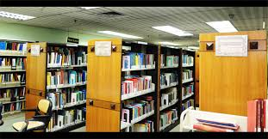
8. PROVIDING A REFERENCE LIBRARY IN THE ARCHIVAL INSTITUTION
It is useful for the archival institution to maintain a small reference library.
The staff will use it to support them in their professional duties, and readers will use it to aid them while they are researching in the archives.

Slide 16
Conclusion
While handling users request, archives staff should always remember that the safety of the documents remains their paramount duty.
Documents are particularly vulnerable when they are being handled by inexpert people.
Strict enforcement of the rules protects archives and deters people from misusing, or even removing documents.

Slide 17


